Slide 1


Sept. 2025

Slide 2

A moment of silence

Slide 3
American Medical Hearing Center
Your Fort Myers / Daniels Parkway / Lehigh Acres Local Hearing Care Expert

Slide 4
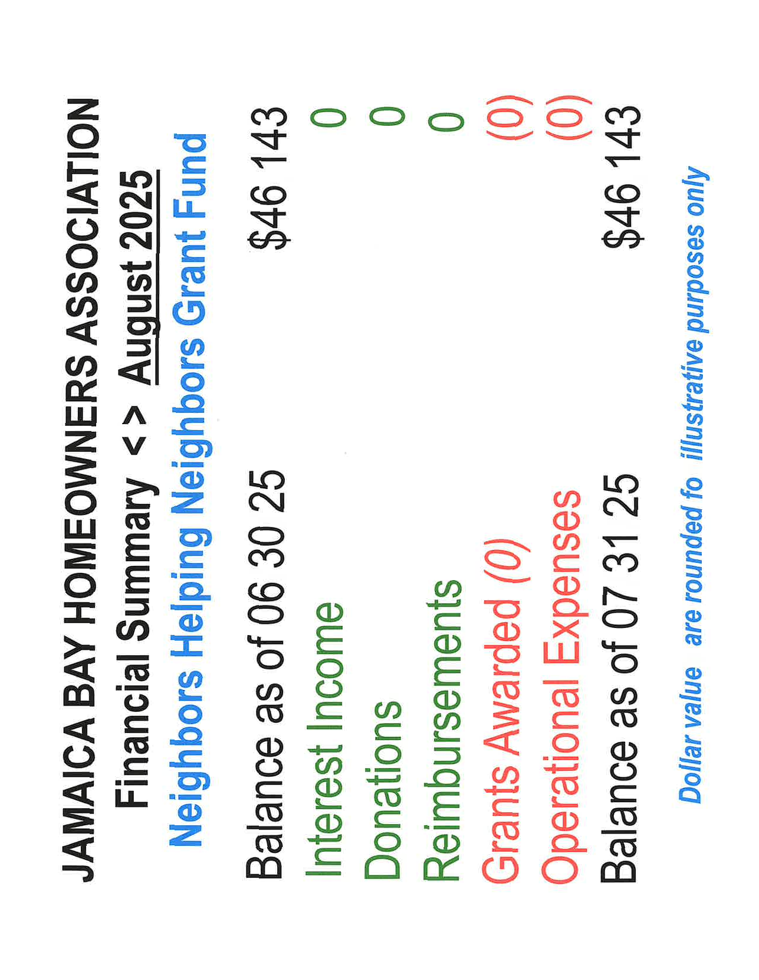

Slide 5
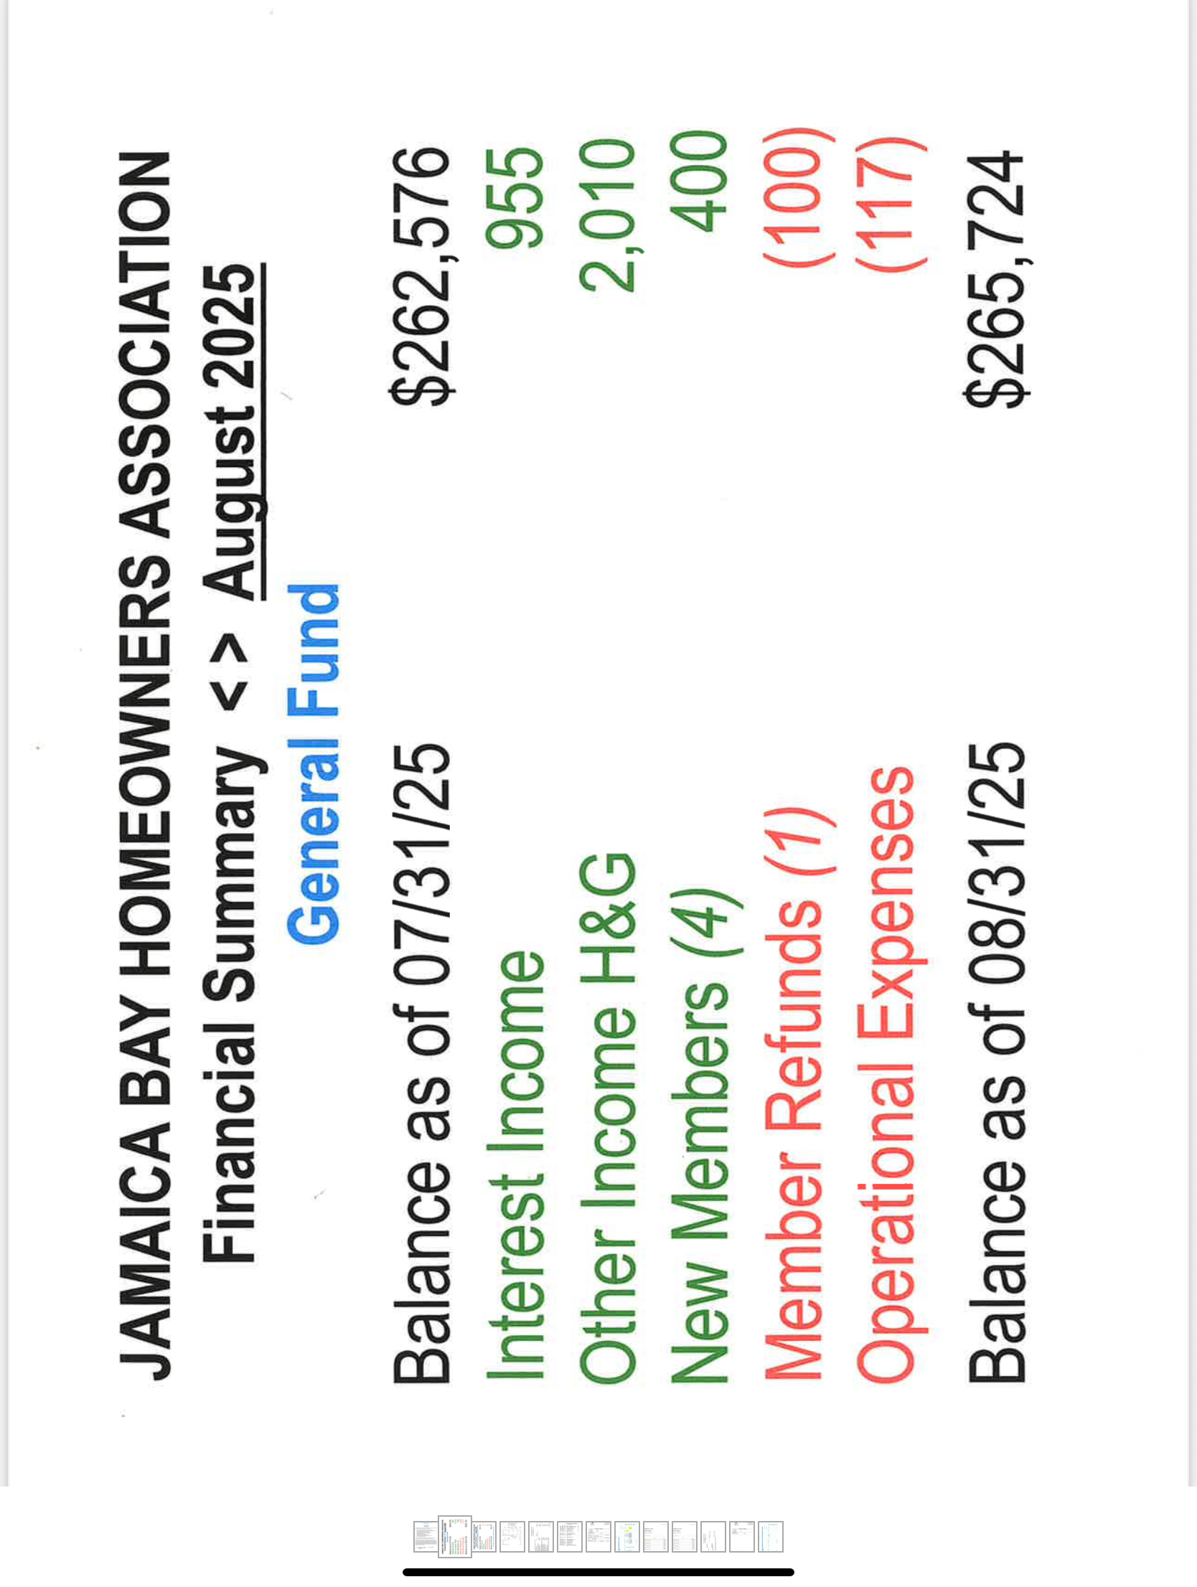

Slide 6

Might as well jump right in
ThePhoto by PhotoAuthor is licensed under CCYYSA.

Slide 7
Your Rent Team for 2025
Steve Albert
Susan Cooney
Darlene Conard
Pam Dodoff
Jane Lilley

Slide 8

Was it a good summer???
We started our meetings on 5/2
We have met, as a team, two dozen times
Steve, and or Susan and I have met an additional 8 times

Slide 9
Additionally, the team visited all of the parks sited in the appraisal report so we could get a first hand impression.

Slide 10

We got a little brain dead

Slide 11
In addition, as a team, we have met with Cove – Mike Rosenhagen, Regional; Dawn Rampf, COO; Myra Carroll, our Park Manager and Abbie Hoheisel

Slide 12
As if we weren't sick of each other enough.........
We also met twice with the HOA's lawyer.

Slide 13
Preparation:
Extensive research was done by this team. No stone was left unturned. We were advised going into the Cove meeting – they wouldn't have a number for us. They didn't.

Slide 14
Before I tell you what we have learned
Rest assured – we have your backs. We are taking this all the way. We are pushing hard for YOU!

Slide 15
What we know
OUR GOAL: Best rental rate possible
We paid $3,700 for a professional appraisal which compared us to 5 other communities and rated JBV -
"Average" and compared to other Parks, Market rent should not exceed $1,200 before taxes

Slide 16
Con't
We highlighted the CPI 2.7% compared to 9% - last rental talk
We spoke to the 2 pages of lost services and how a rent reduction was required
We spoke of the current situation – 45 empty lots

Slide 17
Con't
Only 6 new homes coming in
Cove has the new property tax rate but wasn't in a position to share yet.
They agreed to another meeting set for Sept 24th.

Slide 18
Con't
Per 723 – they have to send out a 90 day notice to all residents – on Sept. 24th they will have to know what will be in that notice.

Slide 19
Con't
Unfortunatey also per 723, they do not have to tell the HOA prior to mailing out the notice.

Slide 20
What we don't know......
We don't know what the rental percentage increase will be.
We don't know what else they are going to try and get in there. EXCEPT for

Slide 21
Changes in Lot Designations
Before I get into this, let me be very clear – it will affect current home owners only when/if they sell.
It will not affect you till then!!!!!

Slide 22
New Lot Designations
There are 8 categories and they range from a low of $1624 to a high of $1725. We will put their map up on our web page.

Slide 23
Attorney Meeting yesterday
We provided our attorney will all the potential issues that we see. She is attending to them line by line and will discuss with us prior to our next Cove meeting.

Slide 24
Lawyers initial comments:
She felt that we had good arguments.
She thought we had done an extraodinary amount of research and we were well prepared.

Slide 25
Our plans
We are all hoping for a negotiation that results in a reasonable outcome but we are prepared for a long battle.

Slide 26
Here is the Process
You are going to get the 90 notice of proposed rent increase
The HOA will get a copy and we will begin the process as outlined in 723 and as discussed with our attorney

Slide 27


Slide 28

Explanation

Slide 29

Con't

Slide 30
October HOA Meeting
Due to the Veranda floor being done, we can't have a meeting there. We are looking at other venues. We will keep you advised.

Slide 31

Questions????????

